Slide 1
Forests in Poland and Europe. Characteristics and management.
Libbert Rocky Ravine

Slide 3
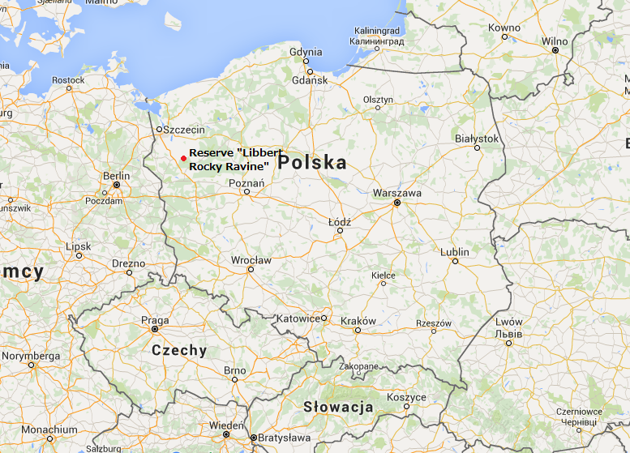

Slide 4
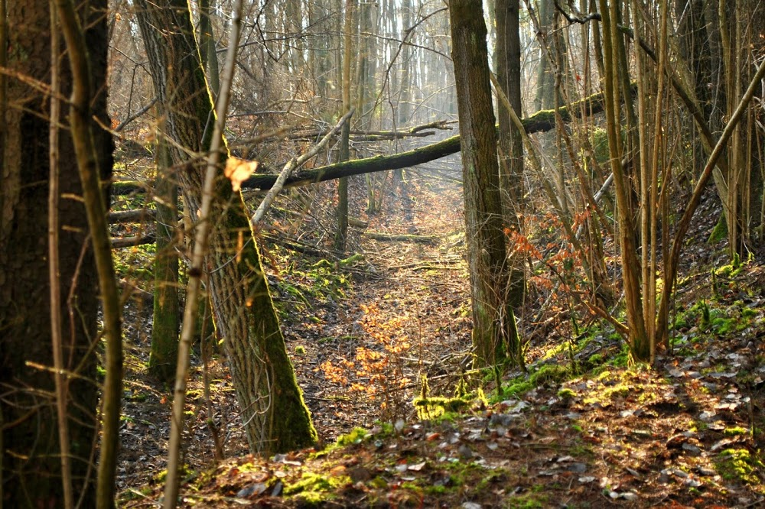
Location :
Poland
53°03′25″N 15°11′02″E
Province :Zachodniopomorskie
County : Myśliborski
Borough: Barlinek
Around the village Równo
Reserve located in the valley Płonie, in the north-west of Barlinecko-Gorzowski Park Scenic periphery. Author: Jacek Gid

Slide 5
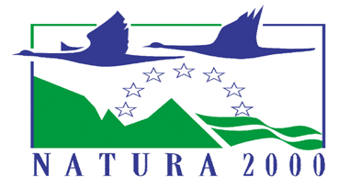
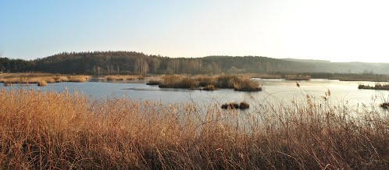
Three forms of nature protection:
Designation of NATURA
2000 sites (PLH 320006)
Reference ecosystem
Establishment of nature
reserve
Author: Piotr Dębski

Slide 6
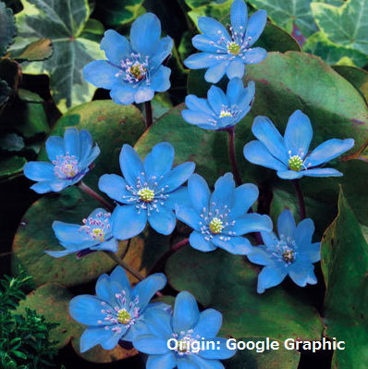
Plants and wildlife under protection :
cuckoo pint (Arum maculatum)
hepatica common (Hepatica nobilis)
lily of the valley (Convallaria majalis)
cotton mouth(Sonchus palustris)
grape banberry (Actaea spicata)
guelder rose (Viburnum opulus)
woodruff (Galium odoratum)
eerie violet (Viola mirabilis)
common ivy (Hedera helix)

Slide 7
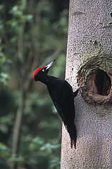
In the world of wildlife :
sand lizard (certa agilis),
black wcommon toad (Bufo bufo),
bree frog (Hyla arborea),
black woodpecker (Dryocopus martius) ,
bittle flycatcher(Ficedula parva) ,
slow worm ordinary (Anguis fragilis) .
Taken from: Google Graphic

Slide 8
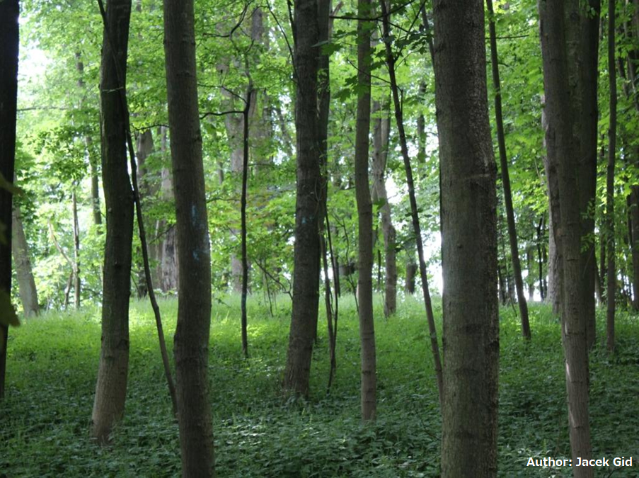
In the consequence of moving glacier in the past, nowadays we have interesting form of landscape for example ravines.
In one of these ravines, you can find many position of quarternary rock form and the original site of sandstone and conglomerates of the calcium carbonate.
WHY IS WORTH TO SEE IT ?

Slide 9
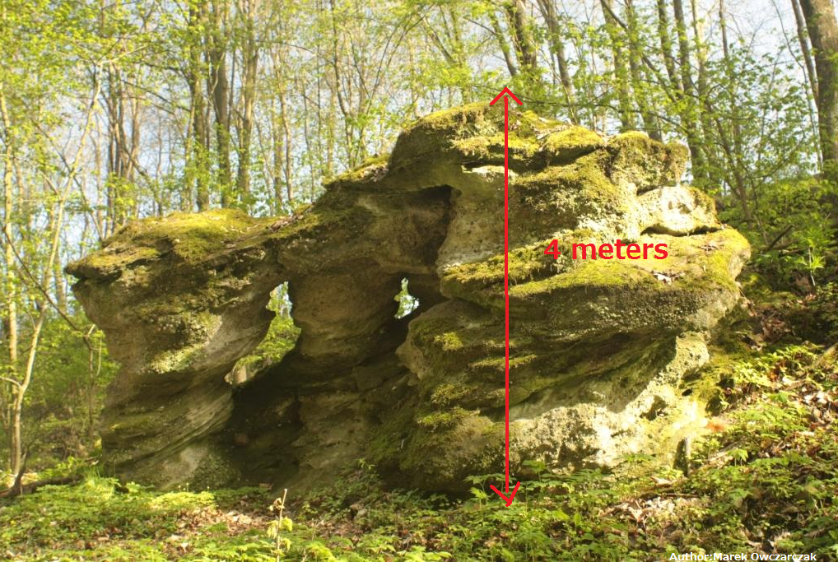

Slide 10
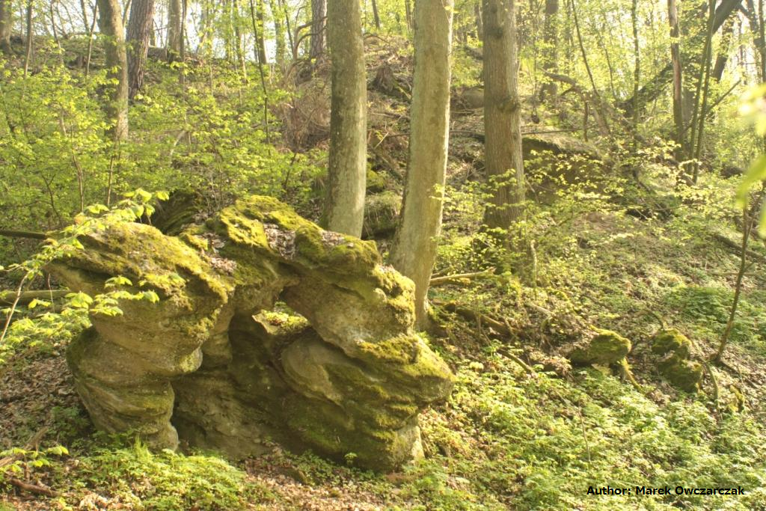
One of them is about almost four meters in high and you can find there numerous boulders. Most of the 700-meter ravine is overgrown with trees beech-oak with a rich layer of undergrowth.
Notes:
One of them is about almost four meters in high and you can find there numerous boulders. Most of the 700-meter ravine is overgrown with trees beech-oak with a rich layer of undergrowth.

Slide 11
The main objects of protection:
Group rocks exposed in the natural process of erosion.
Some worth-seeing advantages of those landscapes, are the erosion of ravine, rocky riverbed and slopes and foothills overgrown forests.
Author: Marek Owczarczak

Slide 12
The entire of „Libbert Rocky Ravine” is covered by partial protection and landscape protection.
Author: Marek Owczarczak

Slide 13
ACTIVITIES RELATED TO CONSERVATION:
-reconstruction of tree stand,
-limitation of tourism in this area,
-setting pheromone traps, -monitoring of those spots, -setting of the protective afforestation, -monitoring by the forest service, -collecion seeds for the silviculture reason.
CONTEMPORARY GEOMORPHOLOGICAL PROCESSES:
The area of reserve which is situated on the edge of moraine boulder was formed by intense water erosion. In the consequence, in this place, arised many ravines which have worth seeing natural features. The process of erosion has caused exposure of the rocks conglomerate and boulders.

Slide 14
THANK YOU FOR YOUR ATTENCION ☺
Natalia Molińska
Karolina Gonerka
Laura Szymańska
„Noblistów Polskich” Middle School in Warnice
Class II B

Slide 15
Source
Record Reserve of „Libbert Rocky Revine” –materials for plan of conservation from 01/01/2006 to 12/31/2025
Ordinance nr 69/2007, Governor of Zachodniopomorskie District,
date 29th October 2007
Wikipedia
Authors of photos
Jacek Gid
Marek Owczarczak
Piotr Dębski
Many thanks to CHOSZCZNO FOREST DISTRICT
for their help and patience☺

